Slide 1


Advancing Southeast Asia’s eCommerce
Notes:
Opening
- It is a great honor to be here today, to share an idea that my team had worked on for the last 5 months. And more than that, we are looking for advices, feedback from everyone to improve and build our business model better.
- After 15 years of evolving, most of everything is moved online, electronically even buying toilet paper according to Amazon’s CEO.
- Anyone in here has never shopped online before? (Expect no hand)...as you can see, it has become a lifestyle in the U.S, everyone shops online.
- Making eCommerce is a lifestyle is a process, not easy to do as it seems. However, as Jack Ma said: “The opportunity is only lie in the place where people complain, there is a problem, there is opportunity.”
Introduction
- From the opportunity of being here in the U.S, the most advanced place of eCommerce, experiencing different type of online trading and new technology, our team has decided to start the project called LucLoi.vn. We are different from others eCommerce sites because of our social media based concept where people can interact with each others easily.
With the mission of:
- Helping everyone to do eCommerce from anywhere in VN fast, secured and efficient.
Vision:
- this project is designed for the future when the users in the region are ready for it.
------------------------------------------------------------------------
- LucLoi.vn is a project of ASEANEcom, a group of young professionals who interested in studying, developing and advancing Southeast Asia eCommerce.
Business Overview
-
Key, Outstanding

Slide 2
“ Is there a better way ? ”
Notes:
Like many startups, the idea for LucLoi started with the question
Is there a better to find a local store nearby? //local SME
Is there a better way to resell my used camera across the country? //used item
Is there a better way to sell with low costs but with a wider reach of buyers?
there must be a better way than facebook and instagram to sell things.
We face the same issues with vietnam in Malaysia
Luckily, I found 2 other people who have the same interest and passion to solve this needs.

Slide 3
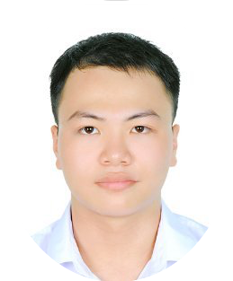





Who are we?
“Meet the passionate people behind the idea”
Dac Khue Nguyen
Huy Le
Cheryl Fong
Co-founder
Computer Science
Founder
Finance and IT
Co-Founder
Electrical Engineer

Slide 4
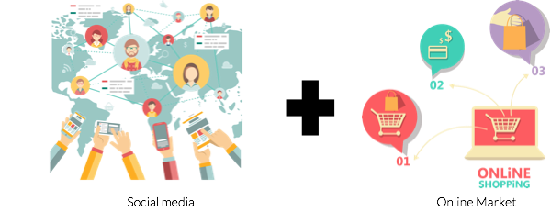
C2C Social Media Based Concept
Notes:
A social media based online market is a new concept of online market which integrated all the features of social media websites like Facebook, Instagram or even Snapchat and Tinder.
Network of seller (Ex: Mutual friend to the seller => create the trust for that seller)
Share your trading activities on your tradefeed (Your friend can comment, hit like or share it to their friend)
Communication is the heart of eCommerce, communication help to build the trust
Trade Feeds: Similar to facebook’s newsfeed, tradefeeds is a constantly updating list of trade activities on your home page. The feed includes store events notification, purchase activity, from status updates from individuals, stores, and collections that you follow on Facebook.

Slide 5
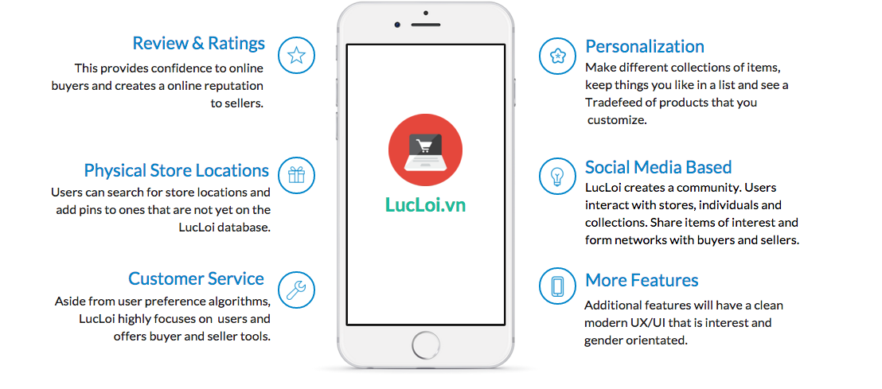
Notes:
Example:
Mr. Tuan wanna buy an item in a random area where he is not really familiar, he could not find the right place nearby. He has to ask surrounded people for the stores which sell the product but not a lot of people know. There has to be a better way for Mr. Tuan to find his item.
=> Local Store Directory, a feature that we offer which can help both users and SMEs.
Users: easier to search.
SMEs: easier to reach customers.
LucLoi’s philosophy: If our users are happy, we are happy. If our users can make money, we can make money.

Slide 6
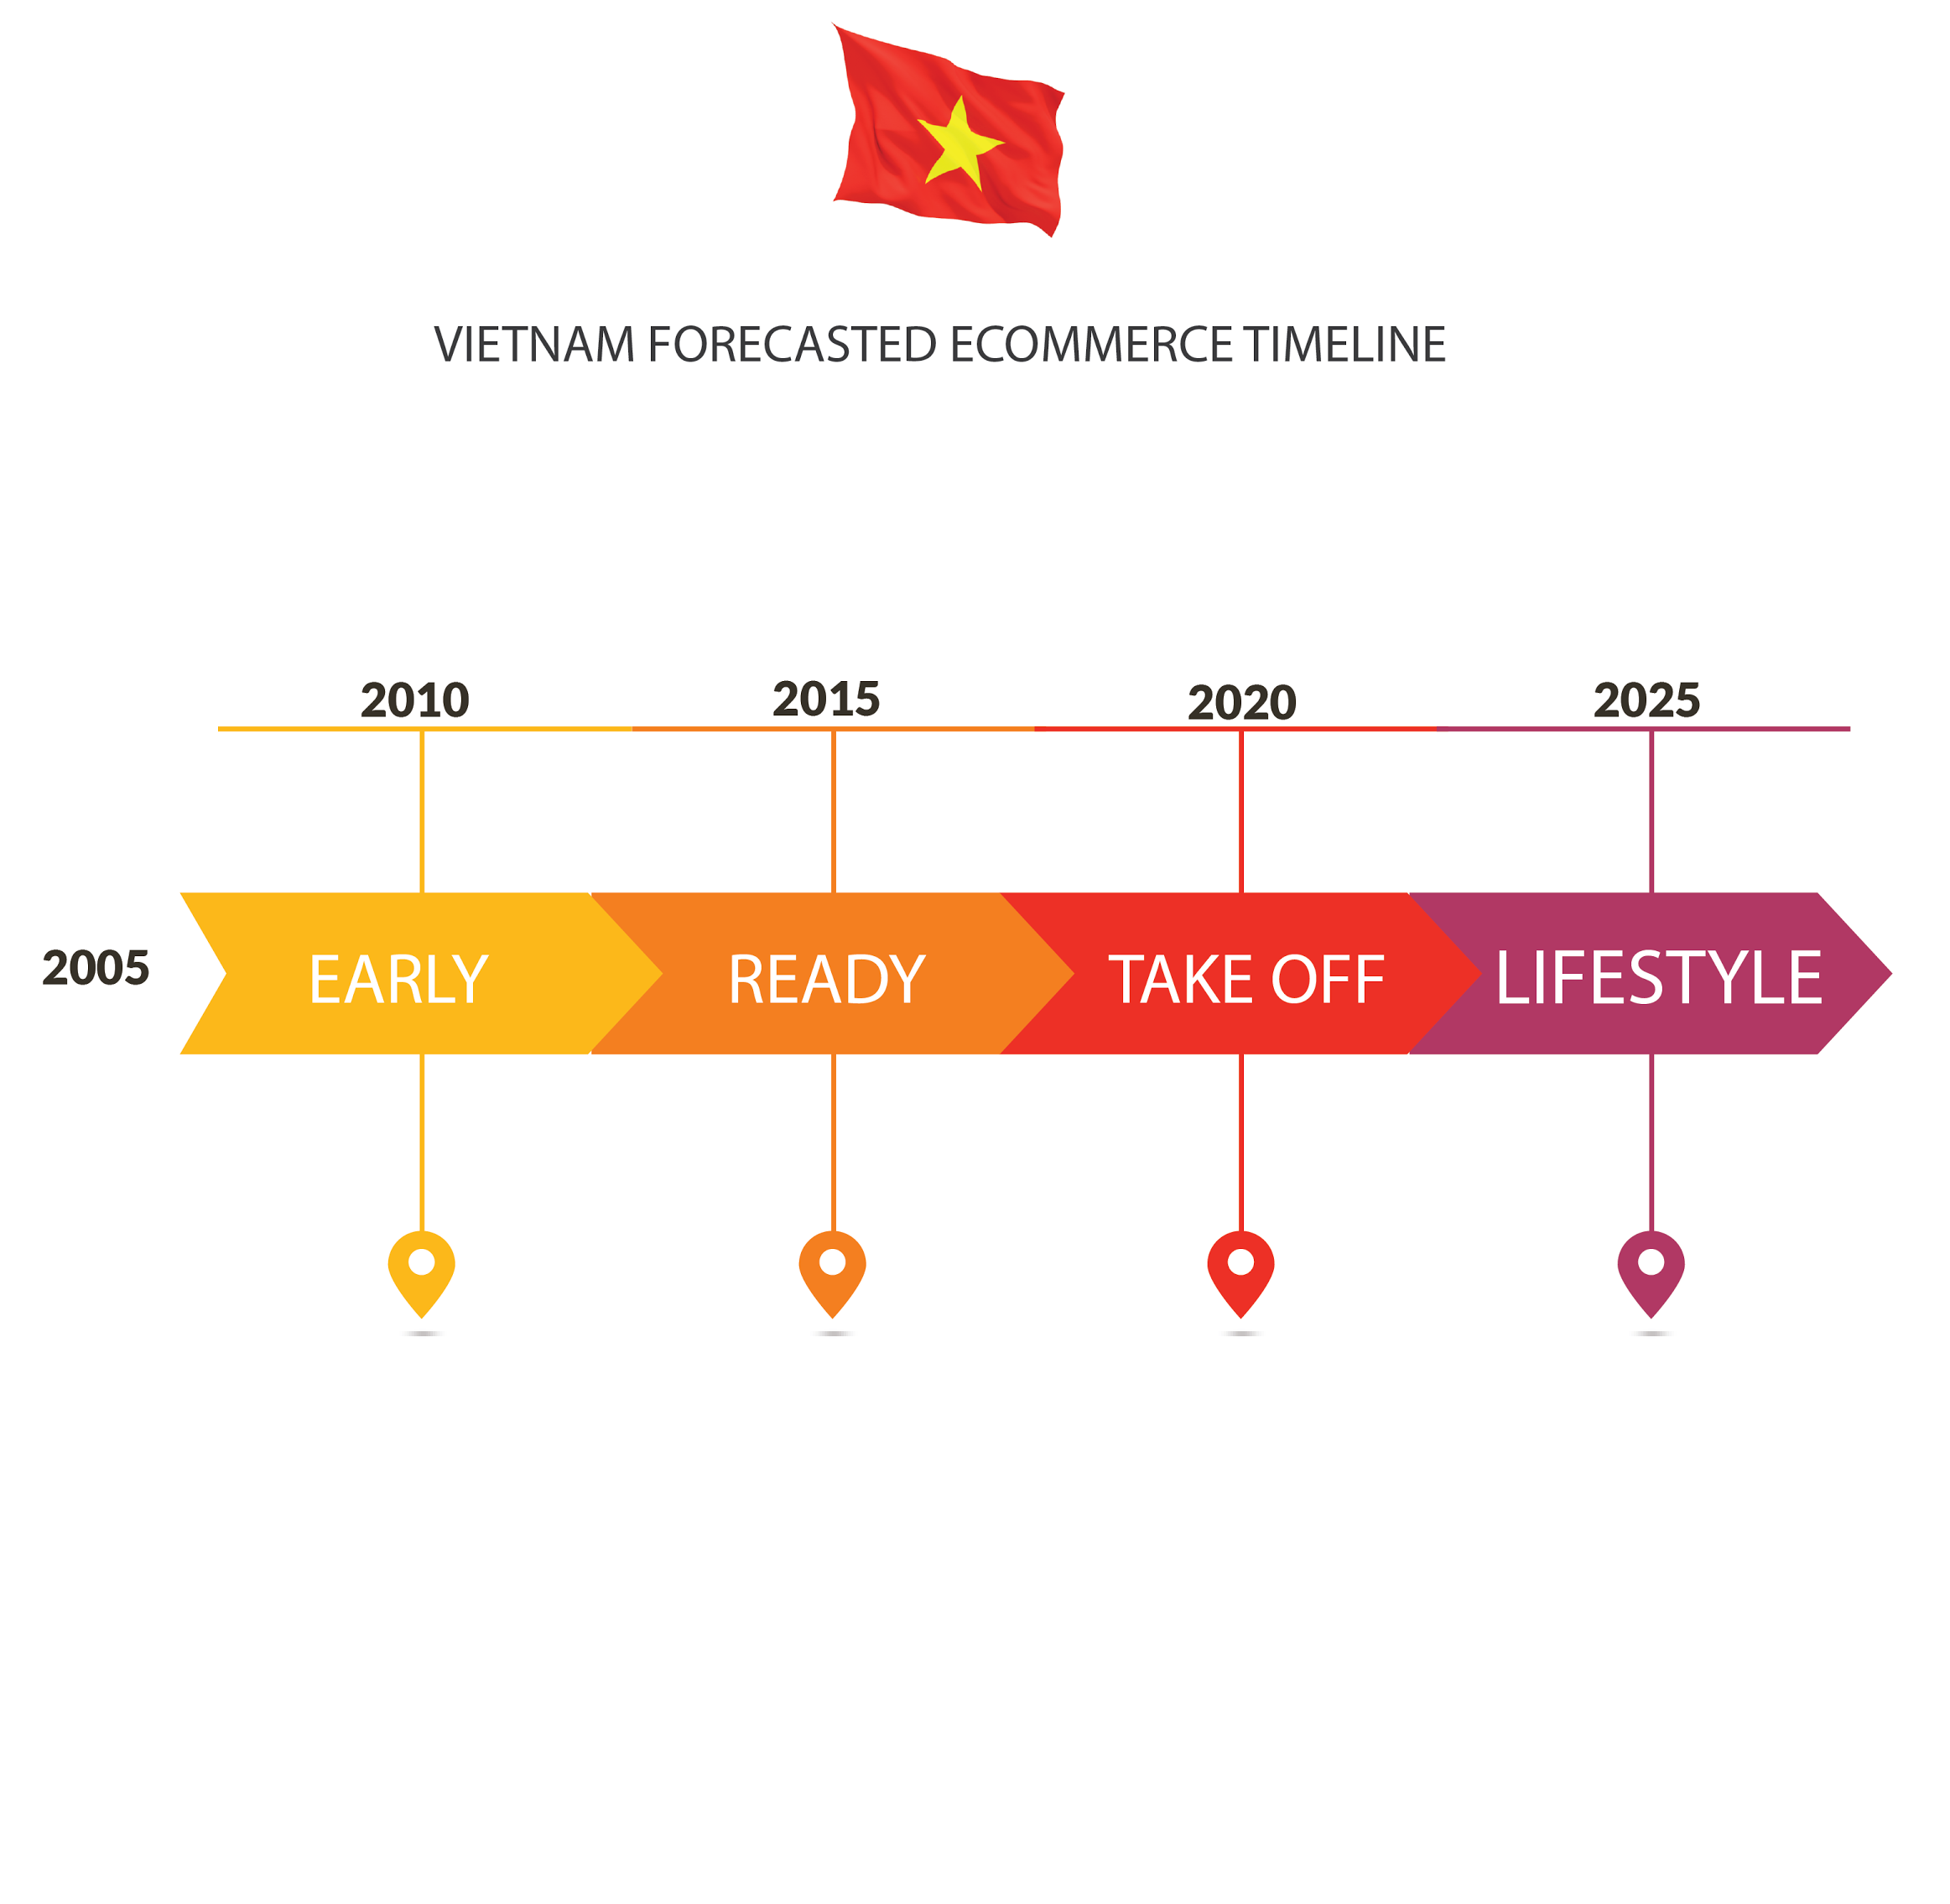
Notes:
Timeline of eCommerce:
Lucloi is built for the future.
Based on research and statistical data, the U.S eCommerce is approximately 5 years ahead of China, and around 20 years ahead of Vietnam.

Slide 7

Advancing Southeast Asia’s eCommerce
Notes:
- We have the chance to be here, to experience the taste of ecommerce as a lifestyle in the U.S.
- We believe that by the time around 2025, Vietnam’s eCommerce will be better.

Slide 8
Business Model
Notes:
HIT NEXT

Slide 9
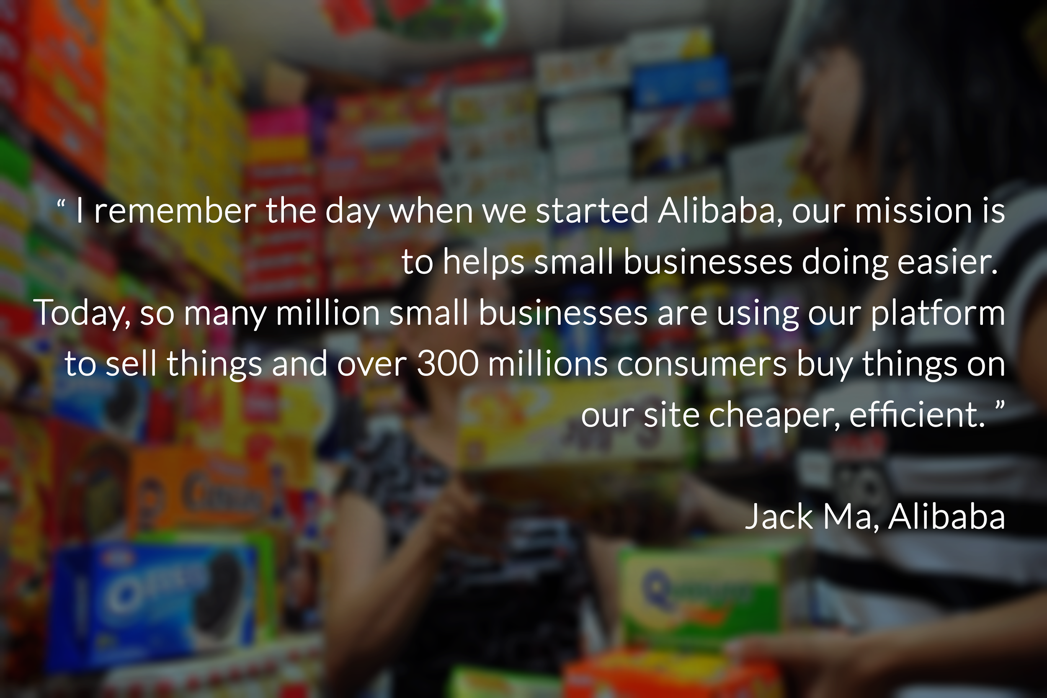
Notes:
I think we all know how Alibaba Group helped improve and changed billion of people life in China.
Money is a byproduct. The Key is we need to understand what do our consumers want, need and their belief.
Negotiation and bargain on prices
Escrow services (Partnership or Our own payment gateway)
Modern UI and technology
Social Media Based concept
Rent Offering Customer Segments:
Model: Online platform services
Target of Revenue (Customer):
Small & Medium Enterprises and individual sellers
User (People who use):
Everyone who has can access to the internet, young people.
Revenue Stream:
Mainstream:
Internal SEO Ads
4 Memberships
Seller Services (Outstanding Listing, pop-up on top of others)
Sale Events, Pages, Blog.
Subscription services.
Substream:
Threshold Transactional Fee/Commision
Free:
Regular Internal SEO Ads
Threshold Transactional Fee/Commision

Slide 10
Q&A

Slide 11




Challenges
Payment System
Consumer Behaviour
Security
Logistics
Notes:
Security
Poor privacy policies.
Identity theft and unauthorized bank account access.
Illegitimate online marketplaces.
Various consumer frauds.
Payment System
Low credit card penetration. Opt for cash on delivery.
Do not see the benefit of putting their cash in banks.
Existing payments systems fall short of creating trust.
Logistics
Poor infrastructure planning.
Lack of technological adaptations to existing services.
Deliveries often get stolen/lost or are late upon arrival.
Consumer Behaviour
Emphasis on inspecting the product before buying.
Many online marketplaces provide vague descriptions and pictures to illustrate products. General skepticism on digital content.

Slide 12

ASEAN e-Commerce Landscape
Males buy 3Cs (Computer, Communication, Consumer Electronic Products)
Females buy fashion, health & beauty, and kitchenware
The growing of ecommerce startups and small businesses (B2C, C2C and online traditional businesses)
The ASEAN E-Commerce is worth approximately $34.5 billion by 2018.
Shopping Online is predicted to become a lifestyle for the people of this region in the near future.
The majority of online trading in SEA is through social media sites like Instagram, Facebook and meet up for payment.

